Slide 1
Transaction Management in the R* Distributed Database Management System
C. MOHAN, B. LINDSAY, and R. OBERMARCK
Zijun Deng, Nuoshi Li

Slide 2
Outline
What is R*?
Transactions in R*
Why commit protocol?
Two-phase commit protocol(2P).
What is Presumed Abort?
What is Presumed Commit?
Comparison between PA and PC.
R*’s approach towards distributed deadlock detection and resolution.

Slide 3
R*
R* is an experimental, distributed database management system(DDBMS).
It is an evolution of the centralized DBMS System R.
R* uses the two-phase locking(2PL) protocol as the concurrency control mechanism.
R* allows deadlocks to occur and then resolves them by deadlock detection and victim transaction abort.

Slide 4
Transactions in R*
Permit multiple data manipulation and definition statements to constitute a single transaction.
Conditional execution and ad hoc SQL statements are available.
The whole transaction need not to be fully specified and made known to the system in advance.
A distributed transaction commit protocol is required in order to ensure either that all the effects of the transaction persist or that none of the effects persist when failures occur.

Slide 5
R* Commit Protocols
Guarantee the uniform commitment of distributed transaction executions.
Each process of a transaction can be undone if the transaction is or needs to be aborted.
Each database of the distributed database system has a log for recovery.
The log records are carefully written sequentially in a file that is kept in stable storage.
Notes:
Guaranteeing uniformity requires that certain facilities exist in the distributed database system.

Slide 6
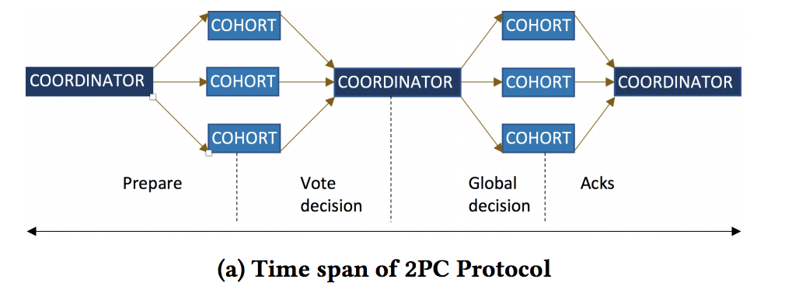
The Two-phase Commit Protocol(2P)
Processes: coordinator and subordinates
The subordinates communicate only with the coordinator.
Transactions and processes are assumed to have globally unique names.
All the processes together accomplish the actions of a distributed transaction.
Notes:
The most common protocol used, at the time, was the two phase commit protocol. When a user decide to commit a transaction, it will contact the coordinator thus starting the 2p committing process. There are two sets of processes in the protocol, one is called the coordinator and the other is the subordinates. There can only be one coordinator while the number of subordinates was not specified. Coordinator communicates directly with the user and the subordinates, while subordinates can not communicate among themselves.
Tramsactions and processes are asumed to have globally unique names, presumably to maintain the three properties of transaction: atomicity, consistency and durability.
Here is just a general timeline for the 2P commitment process, where the coordinator will send out a prepare message to the subordinates, then the subordinate is going to write prepare/abort on the record and respond back to the coordinator with YES/NO vote. Then the coordinator will gather the votes, if all votes are yes, then the coordinator will send out a COMMIT message, subordinates will write down commit/abort and respond back its acknoledgement to the coordinator.

Slide 7
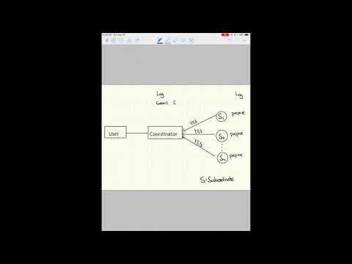
The 2P Commit Protocol Process
https://youtu.be/BagyGqsuISE
Notes:
https://youtu.be/BagyGqsuISE
Here is an demo of process of the 2p commit protocol where all the subordinates sends back YES VOTE to the coordinator.

Slide 8
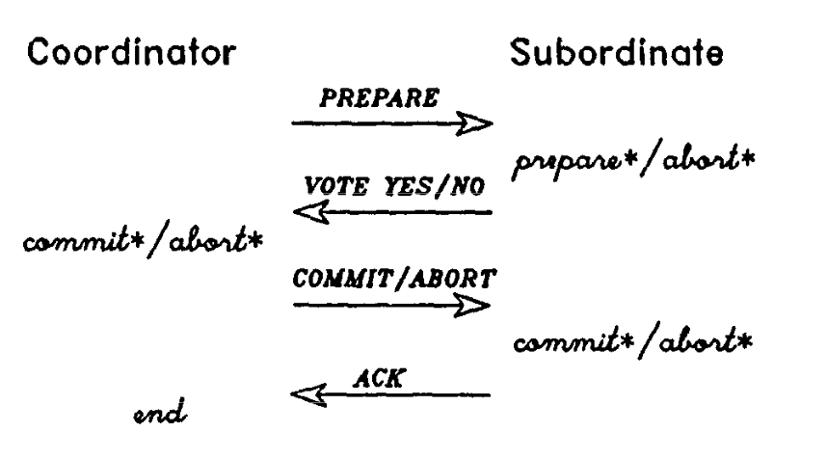
The 2P Commit Protocol Process
For any transaction, each subordinate writes two records and sends two messages(both forced).
The coordinator sends two messages and writes two records(1 forced).
Atomicity[All or nothing]
Notes:
What does it mean for a log to be forced. When forcing a log record, the forced log record and all preceding ones are immediately moved from the virtual memory buffers to stable storage.The transaction writing the log record is not allowed to continue execution until this operation is completed.
This means that, if the site crashes (assuming that a crash results in the loss of the contents of the virtual memory) after the force-write has completed, then the forced record and the ones preceding it will have survived the crash and will be available, from the stable storage, when the site recovers.
It is important to be able to “batch” force-writes for high performance.

Slide 9
Failure and Recovery Process in 2P
Stable storage and virtual Memory
A recovery process exists at each active site.
It handles all the transactions that were executing the commit protocol at the time of the last failure of the site.
Information in virtual storage :
Prepared state for a particular transaction
Committing/Aborting state for a particular transaction
No information
Notes:
As part of recovery from a crash, the recovery process at the recovering site reads the log on stable storage and accumulates in virtual storage information relating to transactions at the time of the crash.

Slide 10
No information!
When a recovery process receives an inquiry message from a prepared subordinate site, it looks at its information in virtual storage.
If no information is found in virtual storage about the transaction, what action should be taken?
Reason: the subordinate has not received and processed a COMMIT / ABORT before the coordinator “forgot” the transaction.
Answer: ABORT!
Notes:
So… Under what circumstances would there be no information stored in the virtual storage. (1)the coordinator sends out PREPARES, (2) coordinator crashes before receiving all the votes and deciding to commit/abort, and (3) on restart, it aborts the transaction and does not inform any of the subordinates.

Slide 11
Hierarchical 2P
Coordinator
N1
N2
N3
Coordinator/
Subordinate
N4
N5
N6
Subordinate
Notes:
Transaction execution model has multi-level of processes, each process/node communicate directly with only its adjacent neighbors. Thus it would not have known about the existence of its non-neighbor processes, making the process pretty similar to those that we’ve just talk about. YAY
Root only acts as the coordinator, leaf only acts as subordinate while non-root, non-leaf nodes act as both . Non-root, non-leaf nodes propogate PREPARE message to its kids, and send the combined vote to its dad/mom. When it get to the PREPARE state, it will propogate COMMIT/ABORT message to its kids and send ACK back to its dad/mom.

Slide 12
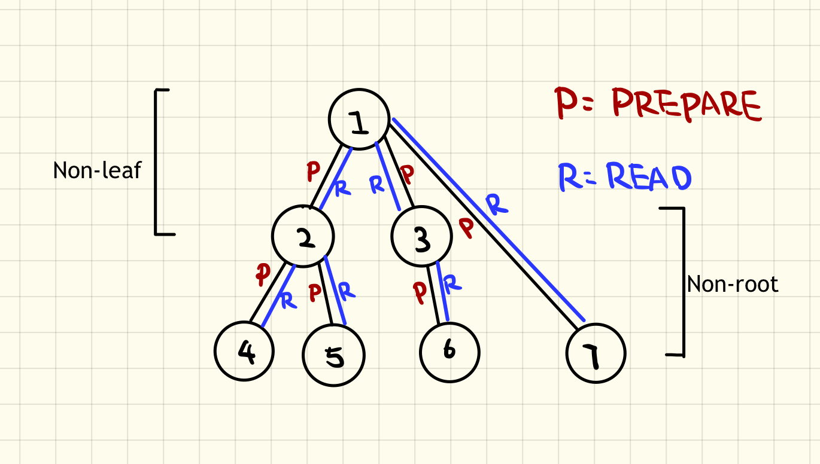
The Presumed Abort Protocol(PA)
A transaction is (completely) read-only if no process of the transaction performs any updates.
For a (completely) read-only transaction, none of the processes write any log records, but each one of the non-leaf processes sends one message (PREPARE) to each subordinate and each one of the non-root processes sends one message (READ VOTE).
Notes:
If a leaf process receives a PREPARE and it finds that it has not done any updates, then it sends a READ VOTE, releases its locks, and ‘forgets’ the transaction. The subordinate writes no log records since it does not matter whether the transaction gets aborted or committed. So the subordinate, who is now known to the coordinator to be read-only does not need to be sent a COMMIT/ABORT by the coordinator. A nonroot, nonleaf sends a READ VOTE only if its own vote and those of its subordinates’ are also READ VOTEs. Otherwise, as long as none of the latter is a NO VOTE, it sends a YES VOTE.
There will not be a second phase of the protocol if the root process is read-only and it gets only READ VOTEs. In this case the root process, just like the other processes, writes no log records for the transaction. On the other hand, if the root process or one of its subordinates votes YES and none of the others vote NO, then the root process behaves as in 2P. But note that it is sufficient for a nonleaf process to include in the commit record only the identities of those subordinates (if any) that voted YES.

Slide 13
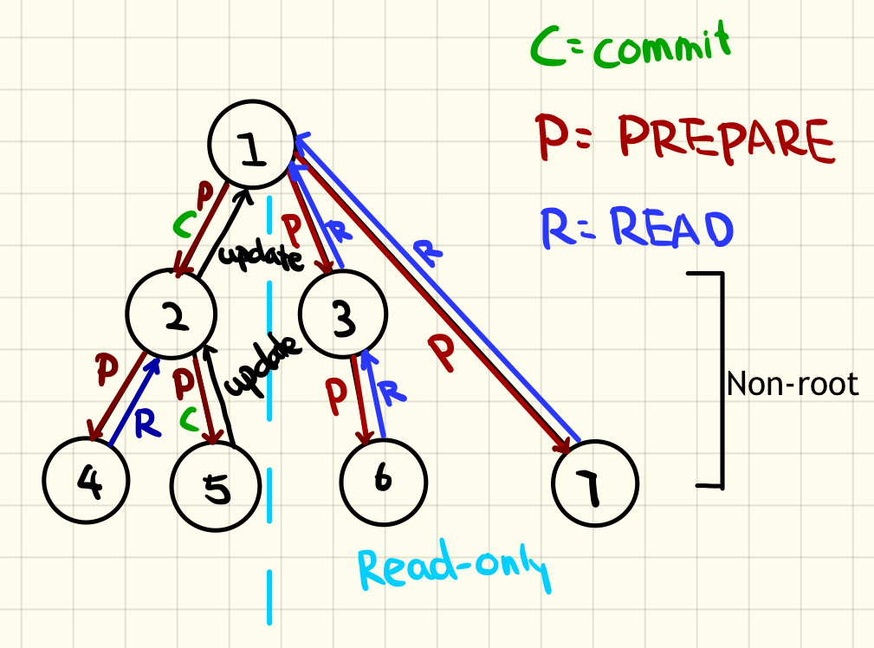
The Presumed Abort Protocol(PA) CONT.
A transaction is partially read-only if some processes of the transaction do not perform any updates to the database while the others do.
For a committing partially read-only transaction, the root process sends two messages (PREPARE and COMMIT) to each update subordinate and one PREPARE to each of the read-only subordinates.

Slide 14
The Presumed Abort Protocol(PA) CONT.
Each one of the non-leaf, non-root processes that is the root of an update subtree sends two messages (PREPARE and COMMIT) to each update subordinate, one PREPARE to each read-only subordinates.
In the no information case, the transaction is presumed to have aborted.

Slide 15
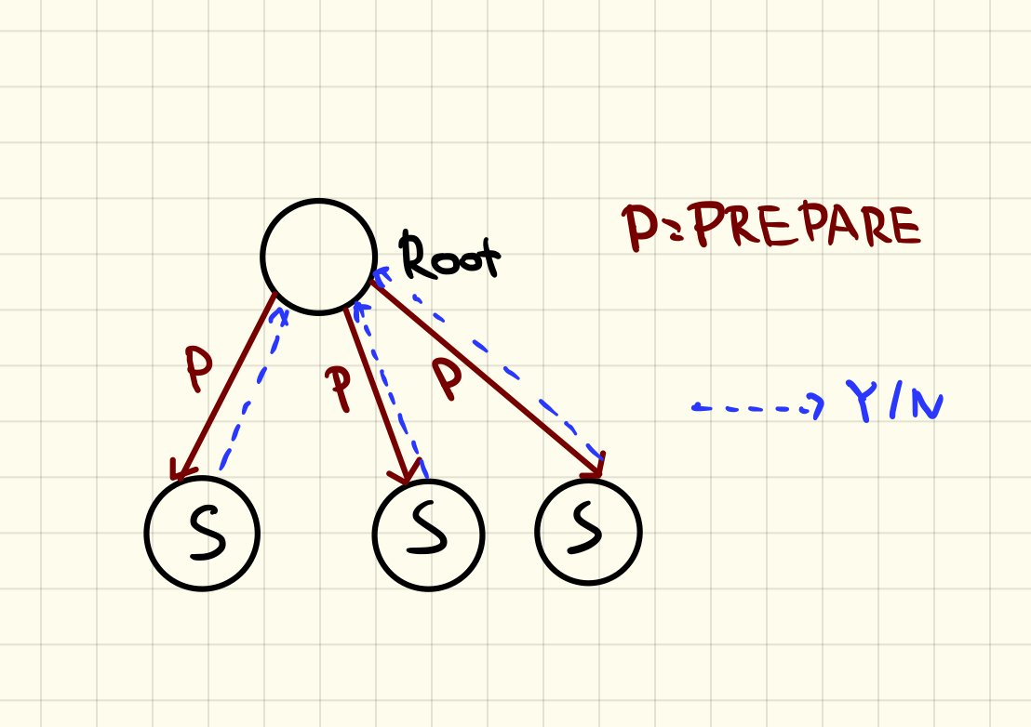
The Presumed Commit Protocol(PC)
In the no information case, the transaction is presumed to have Commited.
Force ACK on abort(cheaper)
Problem: no information if crash after PREPARE.
Solution: Collecting
Notes:
Consider the situation when a root process has sent the PREPARES, one subordinate has gone into the prepared state, and before the root process is able to collect all the votes and make a decision, the root process crashes.
Note that so far the root process would not have written any commit protocol log records. When the crashed root process’s site recovers, its recovery process will abort this transaction and “forget” it without informing anyone, since no information is available about the subordinates.
When the recovery process of the prepared subordinate’s site then inquires the root process’s site, the latter’s recovery process would respond with a COMMIT,7 causing an unacceptable inconsistency.

Slide 16
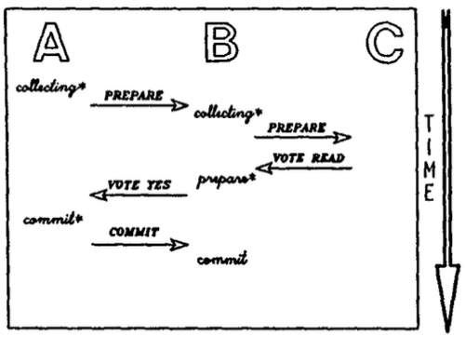
The Presumed Commit Protocol(PC) CONT.
In PC, a non-leaf process behaves as in PA except:
At the start of the first phase, it force-writes a collecting record.
It force-writes only abort records.
It requires ACKs only for ABORTs.
It writes an end record only after an abort record.
Only when in the aborting state will it, on noticing a subordinate’s failure, hand over the transaction to the restart process.
In the case of a (completely) read-only transaction, it would not write any records at the end of the first phase in PA, but in PC it would write a commit record and then “forget” the transaction.
end

Slide 17
The Presumed Commit Protocol(PC) CONT.
In PC, the subordinates behaves as in PA except:
They force-write only abort records and not commit records.
They ACK only ABORTs and not COMMITs.
On restart, if the recovery process finds, for a particular transaction, a collecting record and no other records following it, then it force-writes an abort record, informs all the subordinates, gets ACKS from them, writes the end record, and “forgets” the transaction.
In the no information case, the recovery process responds to an inquiry with a COMMIT.
ACK

Slide 18
Comparison PA VS. PC
Completely read-only transaction
Coordinator | Records Written | # Forced | Message Sent
Presumed Abort | 0 | 0 | 1
Presumed Commit | 2 | 1 | 1
Subordinate | Records Written | # Forced | Message Sent
Presumed Abort | 0 | 0 | 1
Presumed Commit | 0 | 0 | 1

Slide 19
Comparison PA VS. PC
Partially read-only transaction
Coordinator | Records Written | # Forced | Message Sent
Presumed Abort | 1 | 1 | 1
Presumed Commit | 2 | 2 | 1
Subordinate | Records Written | # Forced | Message Sent
Presumed Abort | 0 | 0 | 1
Presumed Commit | 0 | 0 | 1

Slide 20
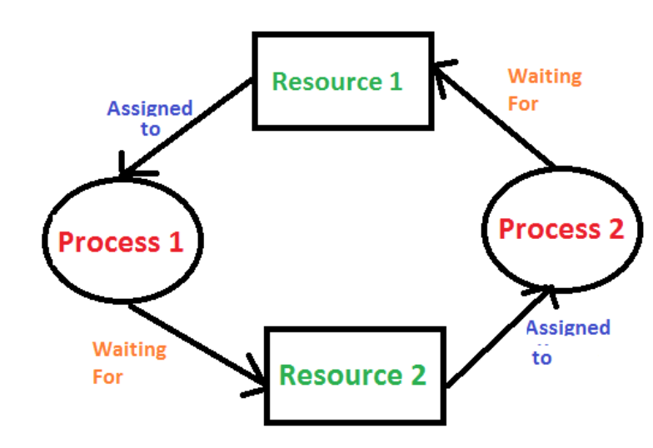
Deadlock Detection & Resolution
Deadlock Detector at each site
Combine to get Potential Global Deadlock Cycle
Information from DD is consumed only once
Transaction may not be in the site where deadlock in detected
Remove local transaction / most efficient one
Notes:
Wait for graphwai

Slide 21
References
C. Mohan , B. Lindsay , R. Obermarck, Transaction management in the R* distributed database management system, ACM Transactions on Database Systems (TODS), v.11 n.4, p.378-396, Dec. 1986
https://www.geeksforgeeks.org/introduction-of-deadlock-in-operating-system/
http://www.cs.cmu.edu/afs/cs/academic/class/15721-f01/www/lectures/Rstar_distrib.pdf

